Slide 1

nad ---First &second assignment
Name –
Roll no –
Semester –
YEAR –
SUBMITTED TO –
SUBMITTED BY –
DATE OF SUBMITTIION
VIJAY BORATE
IT2K18-56
4TH SEM
2020-2021
SHALIGRAM SIR
VIJAY BORATE
Fri, 14 August2020

Slide 2
TOPIC -1
Algorithm for finding
roots of polynomial
equations

Slide 3
Bisection Method
Algorithm
1)Decide initial values for x1 and x2 and stopping criterion, E. 2)Compute f1 = f(x1) and f2 = f(x2).
3) If f1 * f2>0, x1 and x2 do not bracket any root and go to step 7; Otherwise continue.
4) Compute x0 = (x1+x2)/2 and compute f0 = f(x0)
5) If f1*f0 < 0 then set x2 = x0
Else-->set x1 = x0 & set f1 = f0.
6) If absolute value of (x2 – x1)/x2 is less than error E,
Then -> root = (x1 + x2)/2 write the value of root & go to step 7 else -->go to step 4
7) STOP

Slide 4
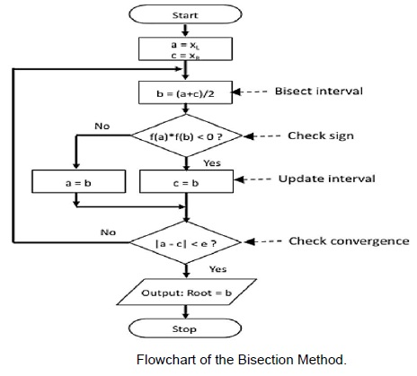
Bisection Method
FLOW-CHART

Slide 5
Regula-Falsi Method
Algorithm
1)Start
2)Read values of x0, x1 and e *Here x0 and x1 are the two initial guesses e is the degree of accuracy or the absolute error i.e. the stopping criteria*
3)Computer function values f(x0) and f(x1)
4)Check whether the product of f(x0) and f(x1) is negative or not. If it is positive take another initial guesses. If it is negative then goto step 5.
5)Determine: x = [x0*f(x1) – x1*f(x0)] / (f(x1) – f(x0))
6)Check whether the product of f(x1) and f(x) is negative or not. If it is negative, then assign x0 = x; If it is positive, assign x1 = x;
7)Check whether the value of f(x) is greater than 0.00001 or not. If yes, goto step 5. If no, goto step 8. *Here the value 0.00001 is the desired degree of accuracy, and hence the stopping criteria.*
8)Display the root as x.
9)Stop

Slide 6
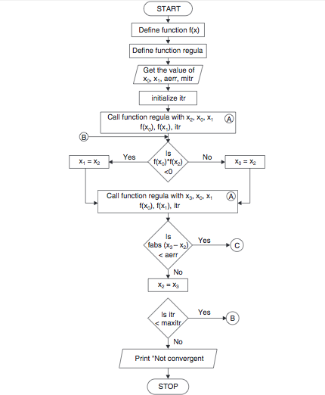
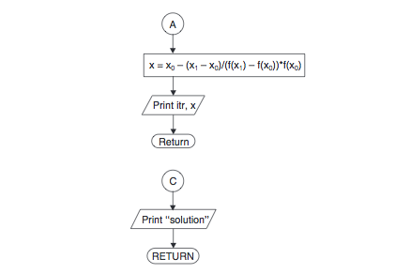
Regula-Falsi Method
FLOW-CHART

Slide 7
Secant Method
Algorithm
1)Start
2)Get values of x0, x1 and e *Here x0 and x1 are the two initial guesses
e is the stopping criteria, absolute error or the desired degree of accuracy*
3)Compute f(x0) and f(x1)
4)Compute x2 = [x0*f(x1) – x1*f(x0)] / [f(x1) – f(x0)]
5)Test for accuracy of x2 If [ (x2 – x1)/x2 ] > e, *Here [ ] is used as modulus sign* then assign x0 = x1 and x1 = x2 goto step 4 Else, goto step 6
6)Display the required root as x2.
7)Stop.

Slide 8
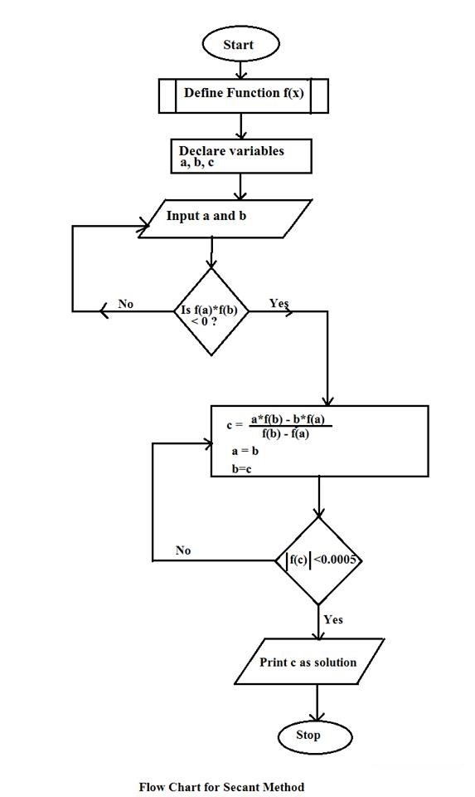
FLOW-CHART
Secant Method

Slide 9
Newton Raphson Method
Algorithm
1)Start
2)Read x, e, n, d *x is the initial guess e is the absolute error i.e the desired degree of accuracy n is for operating loop d is for checking slope*
3)Do for i =1 to n in step of 2
4)f = f(x)
5)f1 = f'(x)
6)If ( [f1] < d), then display too small slope and goto 11. *[ ] is used as modulus sign*
7)x1 = x – f/f1
8)If ( [(x1 – x)/x1] < e ), the display the root as x1 and goto 11. *[ ] is used as modulus sign*
9)x = x1 and end loop
10)Display method does not converge due to oscillation.
11)Stop

Slide 10
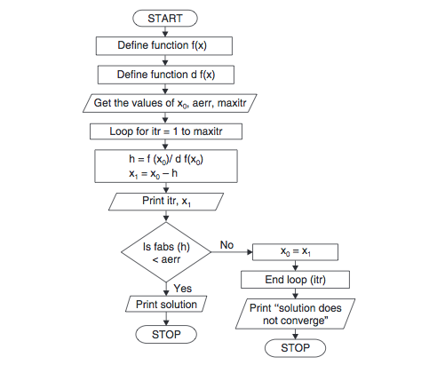
FLOW-CHART
Newton Raphson Method

Slide 11
1)Start 2)Read values of x0 and e. *Here x0 is the initial approximation e is the absolute error or the desired degree of accuracy, also the stopping criteria* 3)Calculate x1 = g(x0) 4)If [x1 – x0] <= e, goto step 6. *Here [ ] refers to the modulus sign* 5)Else, assign x0 = x1 and goto step 3. 6)Display x1 as the root. 7)Stop
Iteration Method Algorithm
Algorithm

Slide 12
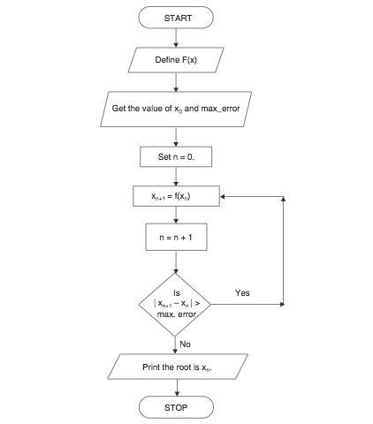
Iteration Method Algorithm
FLOW-CHART

Slide 13
TOPIC -2
Algorithms for applying Interpolation

Slide 14
1. Start 2. Read number of data (n) 3. Read data X_{i} and Y_{i} for i=1 ton n 4. Read value of independent variables say xp whose corresponding value of dependent say yp is to be determined. 5. Initialize: yp = 0 6. For i = 1 to n Set p = 1 For j =1 to n If i ≠ j then Calculate p = p * (xp - X_{j})/(X_{i} - X_{j}) End If Next j Calculate yp = yp + p * Y_{i} Next i 6. Display value of yp as interpolated value. 7. Stop
Lagrange Interpolation Method
Algorithm

Slide 15
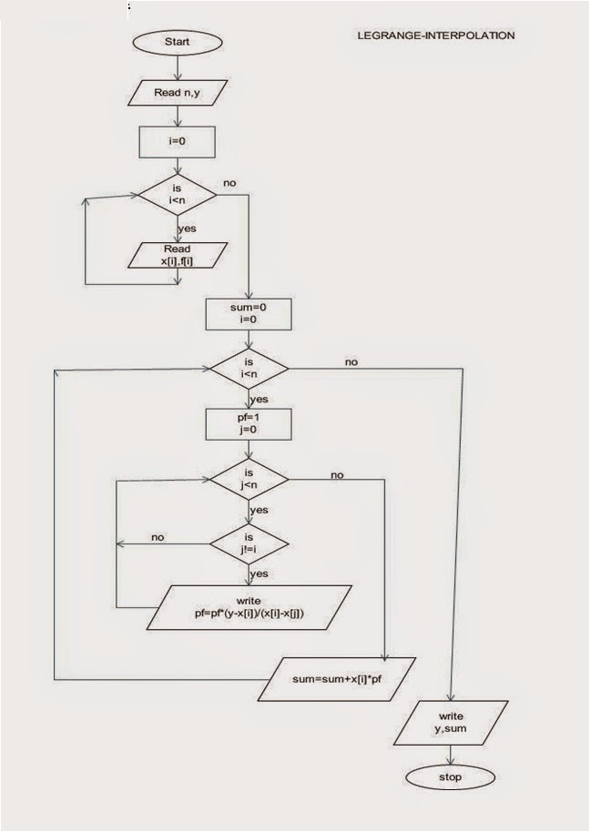
Lagrange Interpolation Method
FLOW-CHART

Slide 16
Newton’s Interpolation Formulas using differences
Algorithm

Slide 17
TOPIC -N Direct Methods for Solving System of Linear Equations

Slide 18
1. Enter the no. of equations, n. 2. Create an nx(n+1) matrix, which will be the augmented matrix. 3. Create an array ‘x’ of size ‘n’ which will store the solutions. 4. Enter the elements of augmented matrix. 5. Pivoting: For i=0 to n-1 For k=i+1 to n-1 If aii<aki , Then For j=0 to n Swap aij with akj 6. Gaussian Elimination: For k=i+1 to n-1 t = aki/aii For j=0 to n-1 akj=akj-t*aij 7. Back-substitution: For i=n-1 to 0 xi=ain For j=0 to n-1 If j != i Then xi=xi-aij*xj xi=xi/aii 8. Print the solution i.e. the elements of x.
Gaussian Elimination.
Algorithm

Slide 19
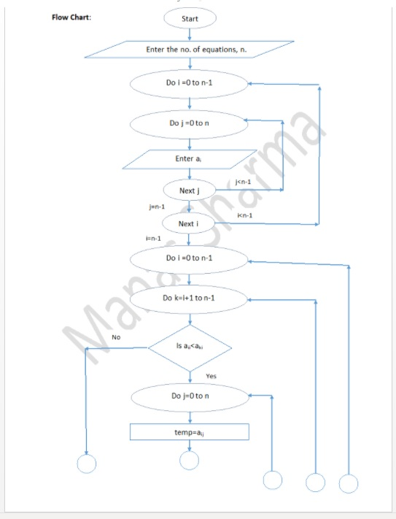
Gaussian Elimination.
FLOW-CHART

Slide 20
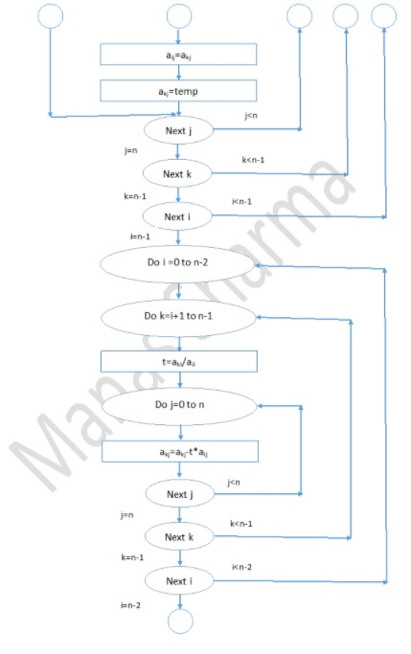

Slide 21
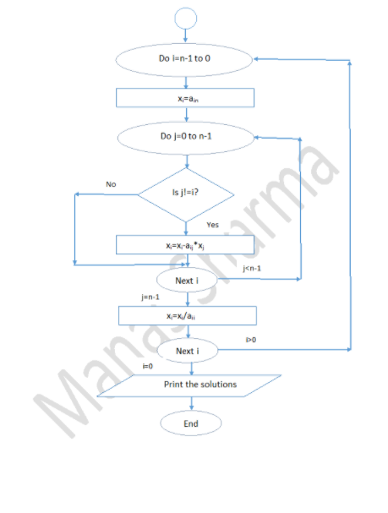

Slide 22
TOPIC -N
Algorithms for Iterative Methods

Slide 23
Jacobi Iteration Method
Algorithm
Start
Arrange given system of linear equations in diagonally dominant form
Read tolerable error (e)
4. Convert the first equation in terms of first variable, second equation in terms of second variable and so on.
5. Set initial guesses for x0, y0, z0 and so on
6. Substitute value of x0, y0, z0 ... from step 5 in equation obtained in step 4 to calculate new values x1, y1, z1 and so on
7. If| x0 - x1| > e and | y0 - y1| > e and | z0 - z1| > e and so on then goto step 9
8. Set x0=x1, y0=y1, z0=z1 and so on and goto step 6
9. Print value of x1, y1, z1 and so on
10.Stop

Slide 24
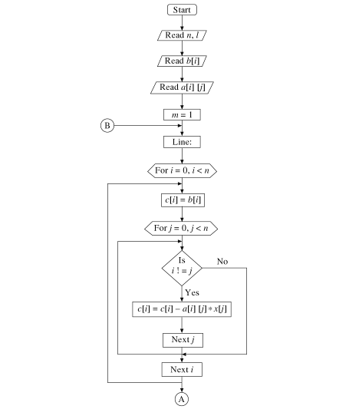
Jacobi Iteration Method
FLOW-CHART

Slide 25
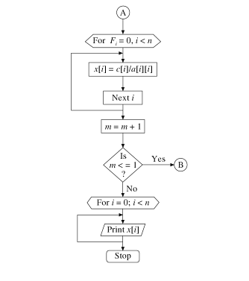

Slide 26
Gauss-Seidel Method
1)Start
2)Declare the variables and read the order of the matrix n
3)Read the stopping criteria er
4)Read the coefficients aim as Do for i=1 to n Do for j=1 to n Read a[i][j] Repeat for j Repeat for i
5)Read the coefficients b[i] for i=1 to n
6)Initialize x0[i] = 0 for i=1 to n
7)Set key=0
Algorithm

Slide 27
8)For i=1 to n Set sum = b[i] For j=1 to n If (j not equal to i) Set sum = sum – a[i][j] * x0[j] Repeat j x[i] = sum/a[i][i] If absolute value of ((x[i] – x0[i]) / x[i]) > er, then Set key = 1 Set x0[i] = x[i] Repeat i 9)If key = 1, then Goto step 6 Otherwise print results

Slide 28
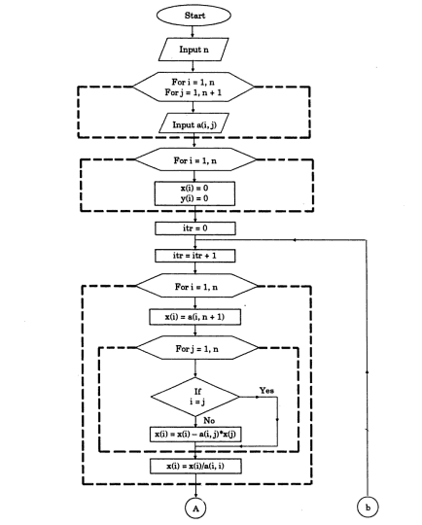
Gauss-Seidel Method
FLOW-CHART

Slide 29
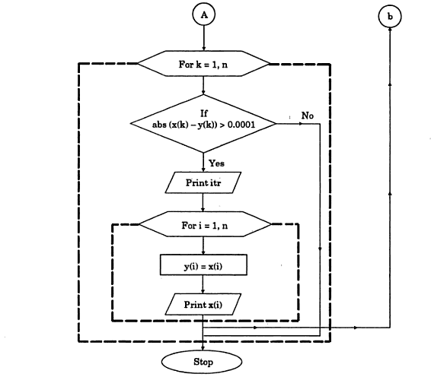

Slide 30
TOPIC -N
Algorithms for Ordinary Differential Equation

Slide 31
Euler Method
Algorithm
1)Start
2)Define function
3)Get the values of x0, y0, h and xn *Here x0 and y0 are the initial conditions ,h is the interval & xn is the required value
4)n = (xn – x0)/h + 1
5)Start loop from i=1 to n
6) y = y0 + h*f(x0,y0) x = x + h
7)Print values of y0 and x0
8)Check if x < xn If yes, assign x0 = x and y0 = y If no, goto 9.
9)End loop i
10)Stop

Slide 32
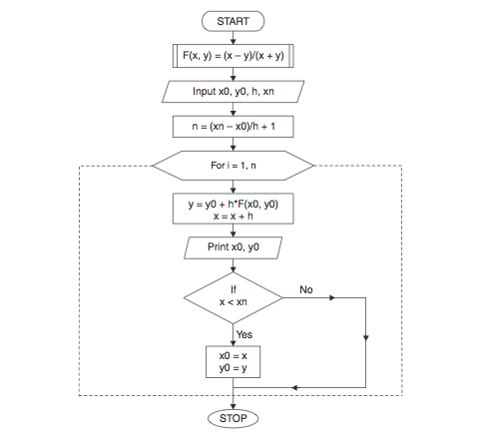
Euler Method
FLOW-CHART

Slide 33
THANK-YOU
second assignment
LINK IN DESCRIPTION

